Slide 1

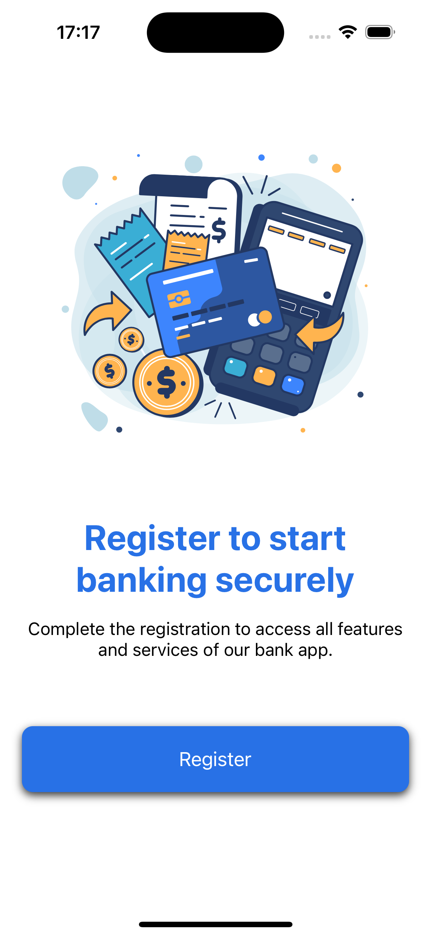
Card App
The Card App is a user-friendly iOS application designed to revolutionize banking experiences by providing seamless functionality. With a focus on simplicity and efficiency, you can register easily, create debit cards, manage their balances, and perform transactions effortlessly.

Slide 2

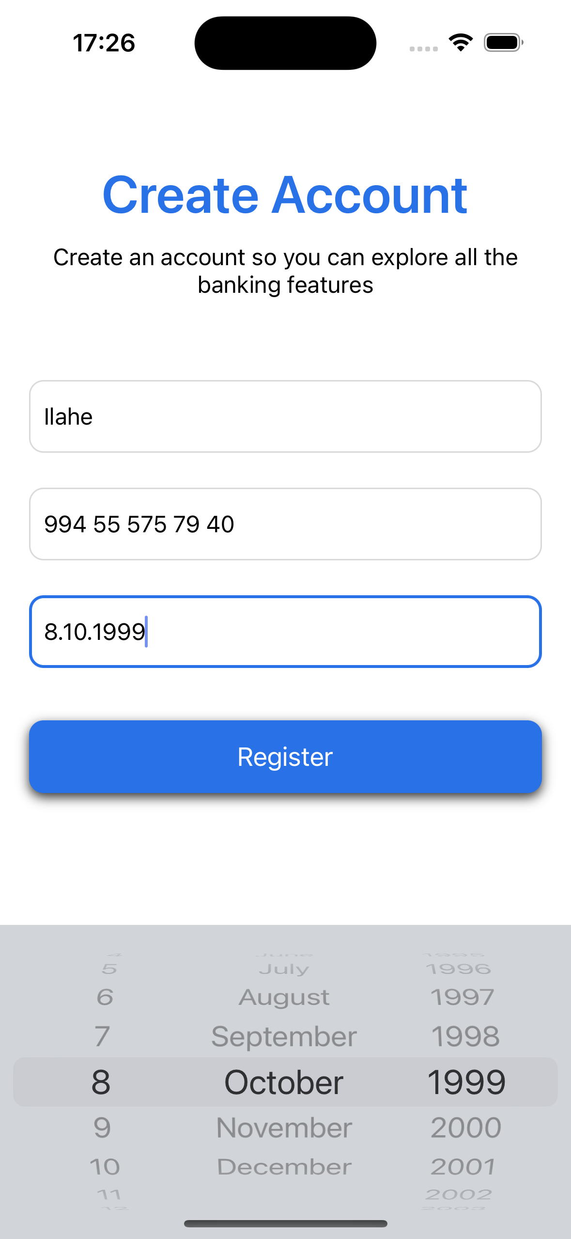
Register screen
Users can sign up by entering their name, phone number, and date of birth. Streamlined registration process ensures a hassle-free onboarding experience. There is no validation on name or dateofbirth

Slide 3


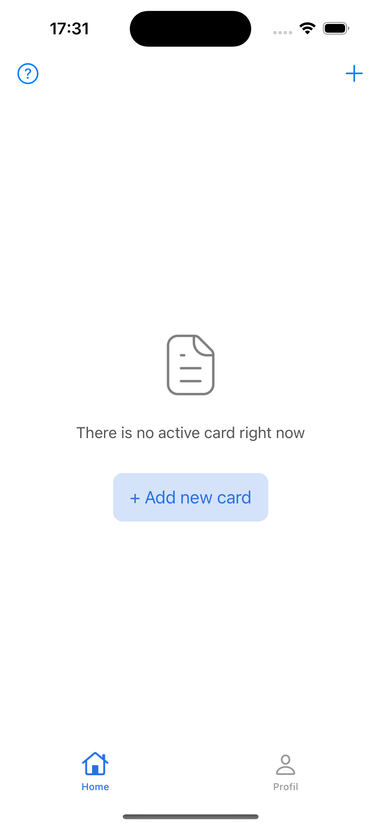
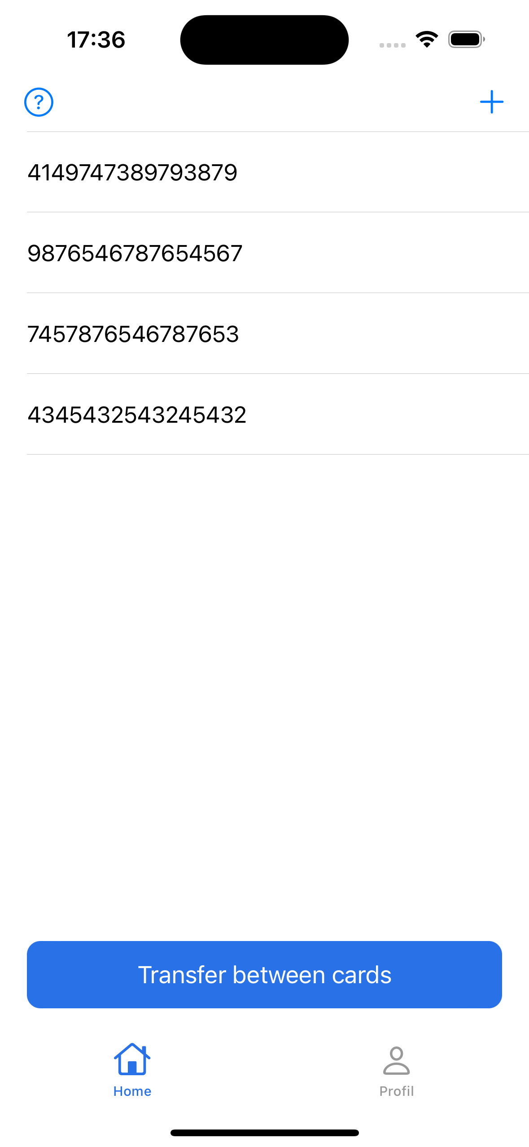
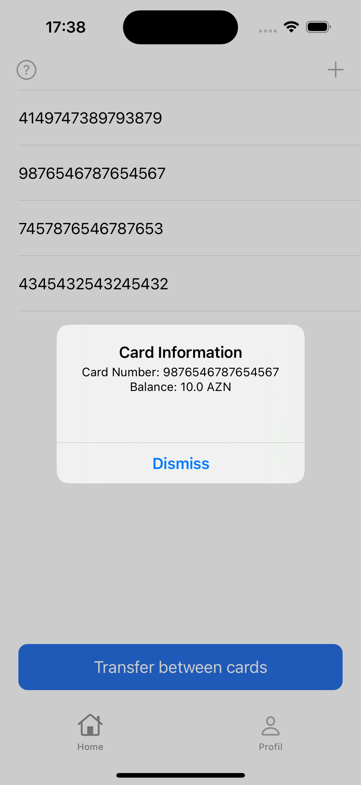
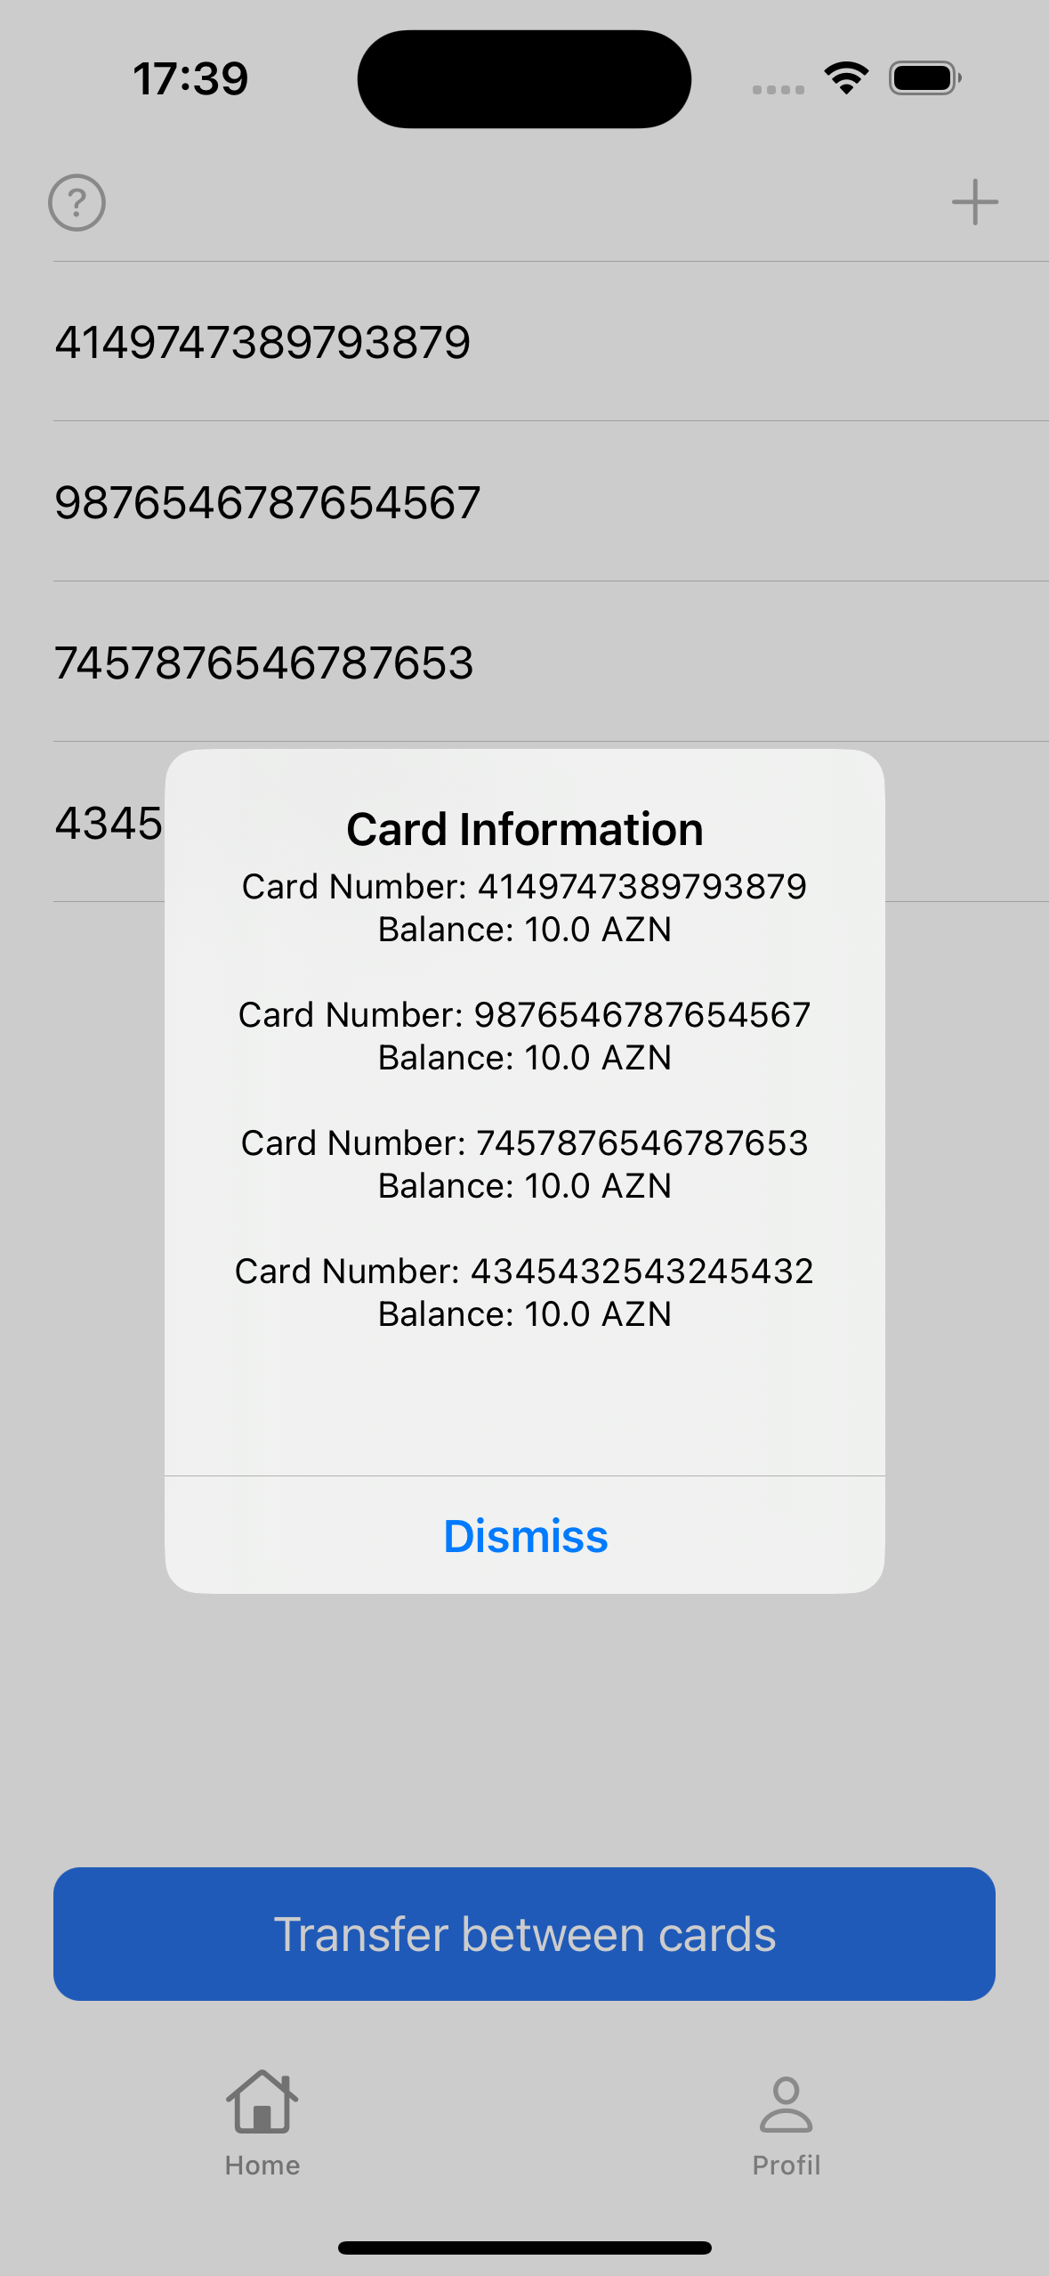
Home Screen

Slide 4

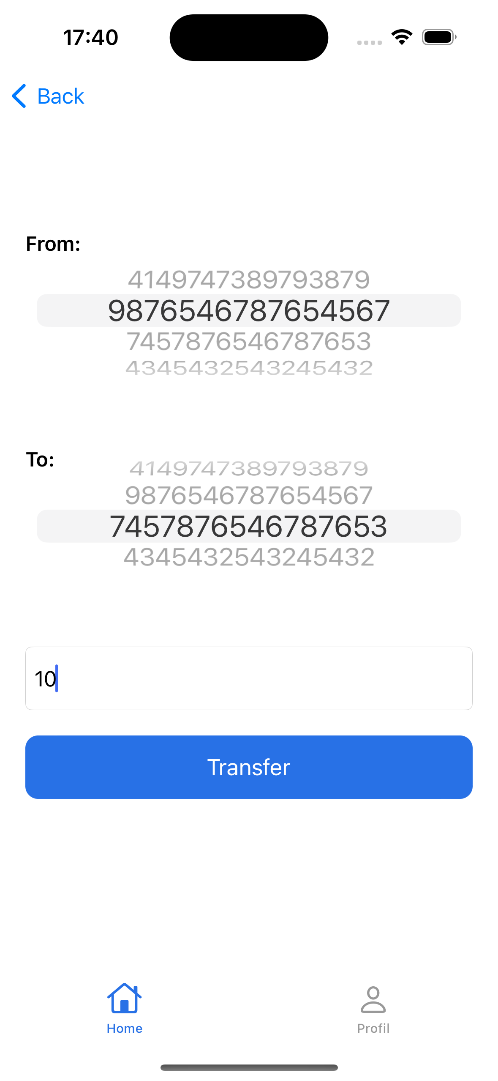
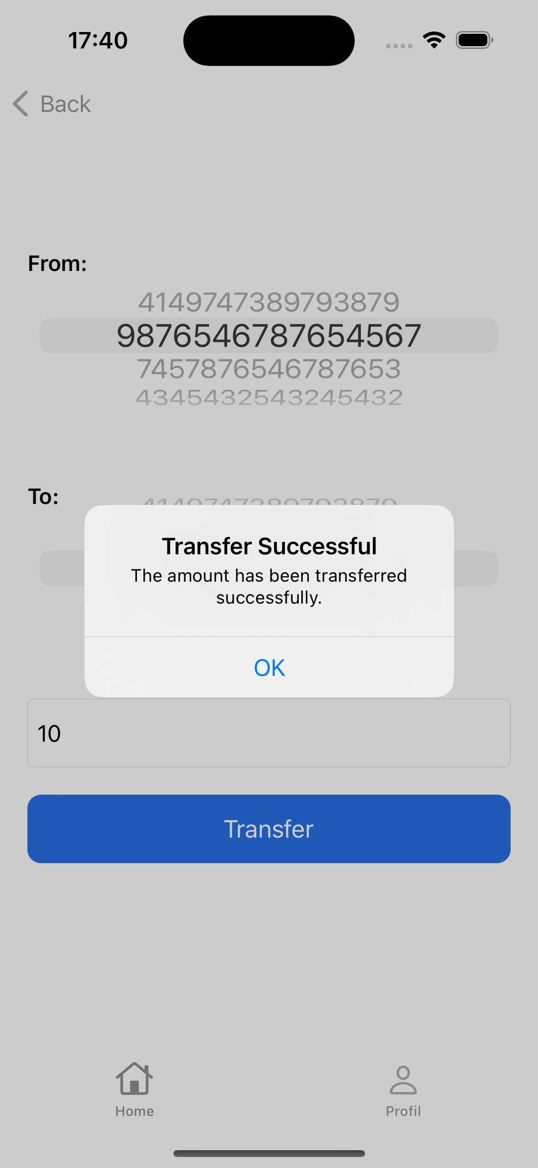
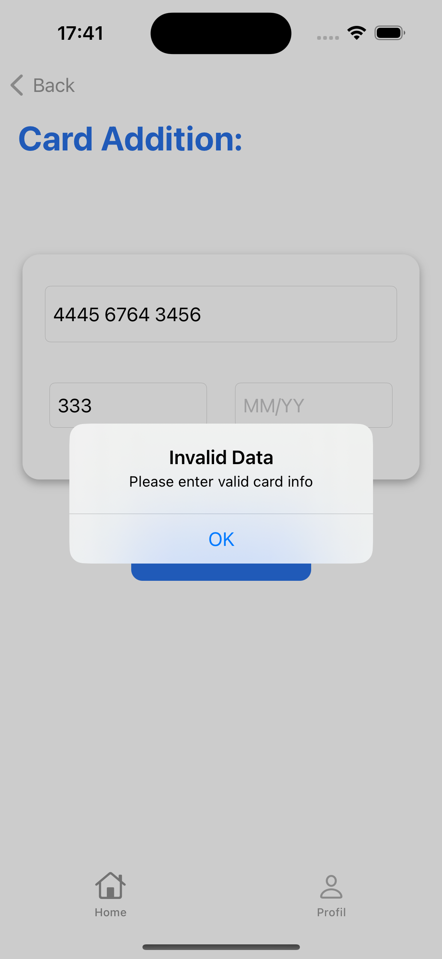
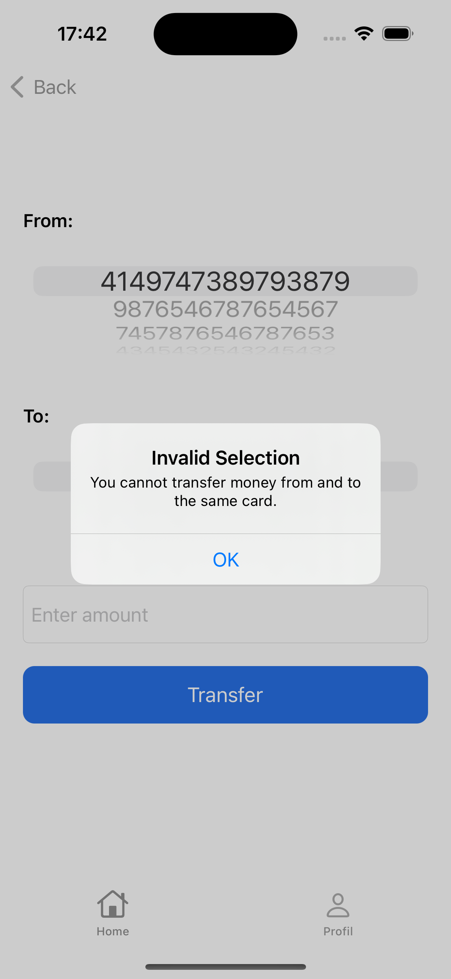
Transfer Screen

Slide 5

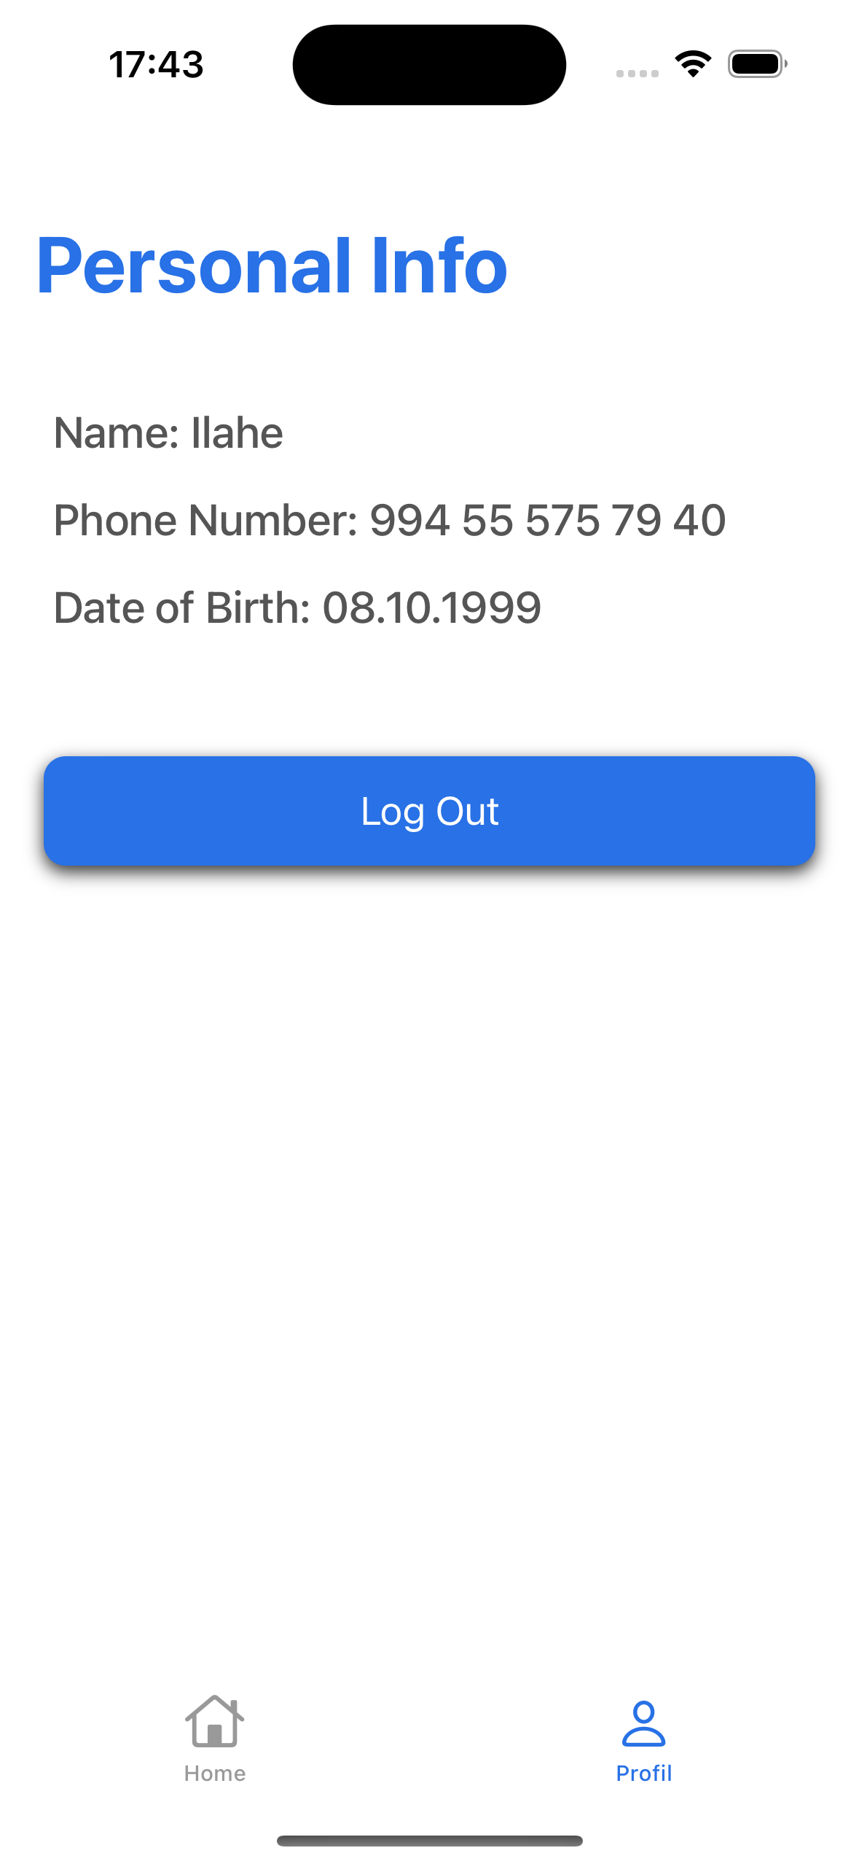
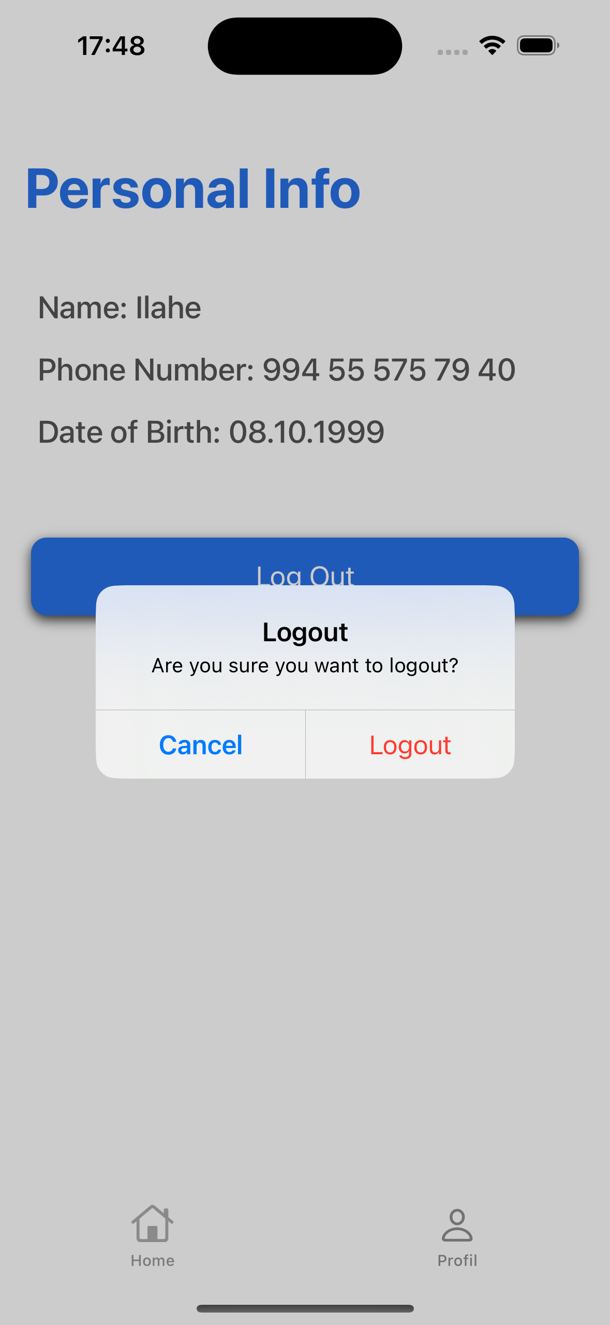
Create apartment, house or room listing
UserDefaults are utilized for storing lightweight data such as user preferences and settings. Keychain is employed for storing sensitive data like passwords and authentication tokens, providing an additional layer of security.

Slide 6
iOS Application Architecture and Design Overview
Architecture Pattern
Local Database
Key Methods Utilized
Libraries
MVVM (Model-View-ViewModel)
Core Data
UserDefaults
Keychain
Snapkit
Lottie

Slide 7
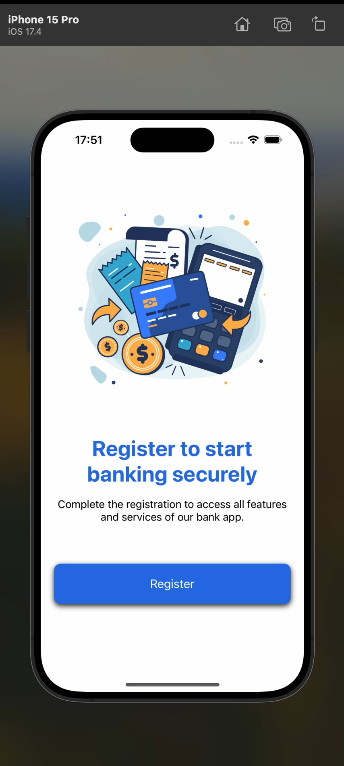

Slide 8
Thank you for your attention!

